Slide 1
Graphical User Interface in MATLAB
Credits:
Angeline Beulah. V, SSN College of Engineering, Chennai

Slide 2
GUI
GUI-Graphical User Interface
  Provide point-and-click control of software applications.
  Eliminate the need to learn a language or type commands in order to run the applications.

Slide 3
Topics to be Covered
How to create GUIs with MATLAB
  Laying out the components
  Programming them to do specific things in response to user actions
  Saving and launching the GUI
Will not go into detail on MATLAB scripts
Will not attempt to cover the "art" of good user interface design

Slide 4
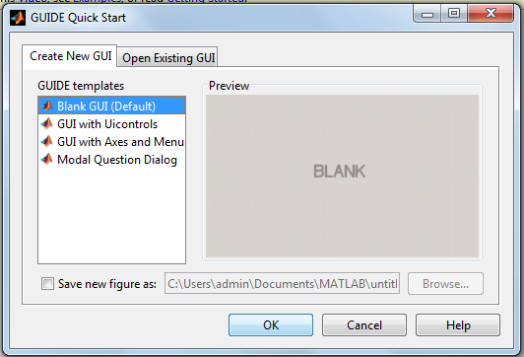
Two ways to open the GUI window
  Click New→Graphical User Interface.(ver R2014a)
  Type guide on the command window.
  GUIDE (Graphical User Interface Development Environment)

Slide 5
GUIDE (Graphical User Interface Development Environment)
GUIDE is primarily a set of layout tools
GUIDE also generates an M-file that contains code to handle the initialization and launching of the GUI
  This M-file also provides a framework for the implementation of the callbacks - the functions that execute when users activate a component in the GUI.

Slide 6
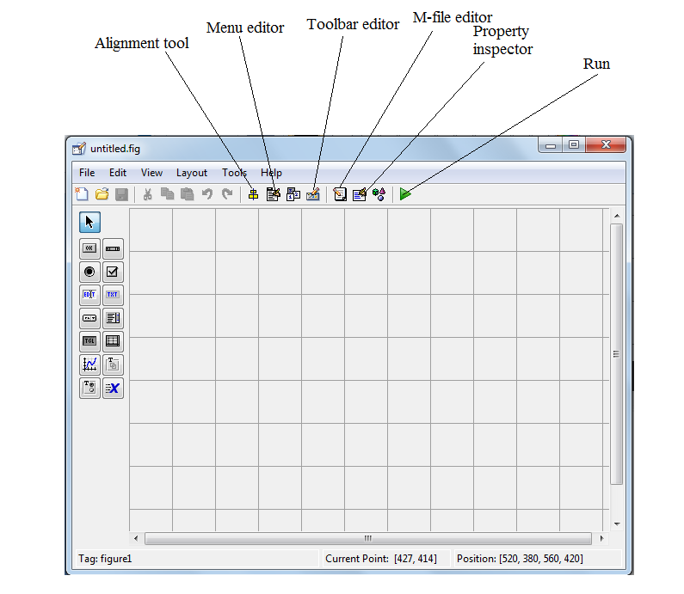
GUI window layout

Slide 7
GUIDE - Primarily a Set of Layout Tools
Control Panel - add and arrange objects in the figure window
Alignment Tool - align objects
Property Editor - inspect and set property values
Object Browser - observe a hierarchical list of the Handle Graphics objects
Menu Editor - create window menus and context menus

Slide 8
Components Palette
  The L.H.S. of the Guide window contains the components palette.
  Your layout-design task will involve dragging and dropping the GUI control components from the palette onto the layout area.
File-> Preferences option of the GUIDE window will allow you to display the names of the items in the components

Slide 9
uicontrol objects
Push Buttons
Toggle Buttons
Check Boxes
Radio Buttons
Edit Text
Static Text
Sliders
Frames
List Boxes
Popup Menus

Slide 10
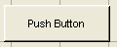
Push Buttons
Push buttons generate an action when pressed (e.g., an OK button may close a dialog box and apply settings)
  When you click down on a push button, it appears depressed;
  when you release the mouse, the button's appearance returns to its non-depressed state;
  and its callback executes on the button up event

Slide 11
Toggle Buttons
Toggle buttons generate an action and indicate a binary state (e.g., on or off)
The callback routine needs to query the toggle button to determine what state it is in
  You can do this with a statement that uses the current callback object's handle (gcbo)
    get(gcbo,'Value')
MATLAB sets the Value property to 1 when depressed and 0 when not depressed

Slide 12
Check Boxes
Generate an action when clicked and indicate their state as checked or not checked
Useful when providing the user with a number of independent choices that set a mode
The Value property indicates the state of the check box by taking on the value 1 or 0
    Value = 1, box is checked.
    Value = 0, box is not checked.

Slide 13
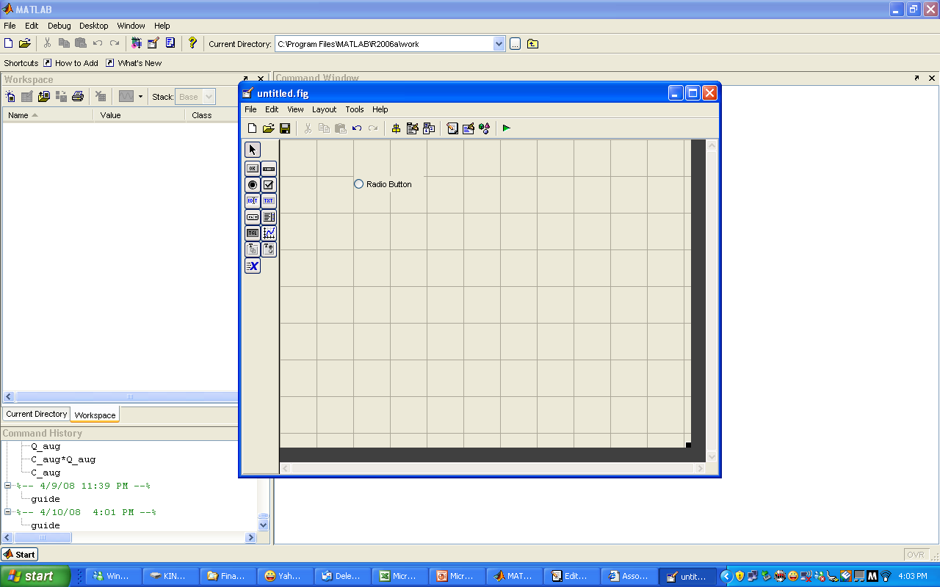
Radio Boxes
Similar to check boxes, but are intended to be mutually exclusive within a group of related radio buttons (i.e., only one button is in a selected state at any given time)
To make radio buttons mutually exclusive within a group, the callback for each radio button must set the Value property to 0 on all other radio buttons in the group

Slide 14
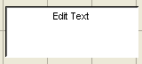
Edit Text
Fields that enable users to enter or modify text strings
Use edit text when you want text as input
The String property contains the text entered by the user.

Slide 15
Static Text
Displays lines of text
Typically used to label other controls, provide directions to the user, or indicate values associated with a slider
Users cannot change static text interactively and there is no way to invoke the callback routine associated with it.

Slide 16
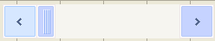
Sliders
Accept numeric input within a specific range by enabling the user to move a sliding bar
The location of the bar indicates a numeric value
Can set Current Value, Range, and Step size

Slide 17
List Boxes
Display a list of items (defined using the String property) and enable users to select one or more items
By default, the first item in the list is highlighted when the list box is first displayed
  If you do not want any item highlighted, then set the Value property to empty, []

Slide 18
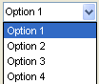
Popup Menus
Open to display a list of choices (defined using the String property) when users press the arrow
When not open, a popup menu displays the current choice, which is determined by the index contained in the Value property
  The first item in the list has an index of 1
You can query the Value property in the callback routine to determine which choice the user made
Can be used in place of Radio Buttons

Slide 19
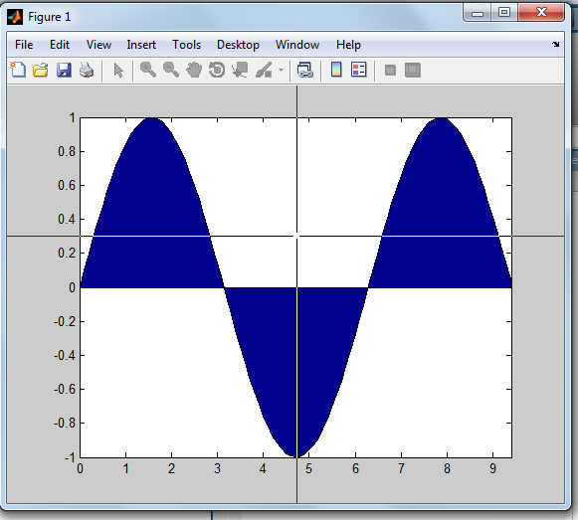
Commands
Example:1
x=0:0.1:3*pi
y=sin(x)
area(x,y)
[x,y]=ginput(1)
%plot(x,y)
Output:
>> first
x = 4.7541
y = 0.1257

Slide 20
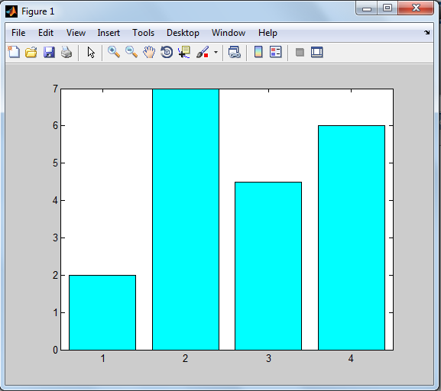
Example:2
bar([2,7,4.5,6])
colormap cool

Slide 21
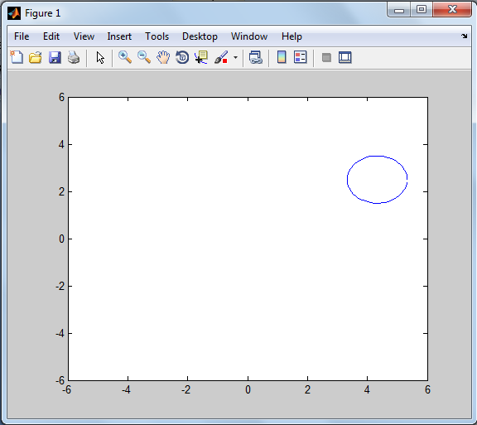
Example:3
T=0:0.1:2*pi;
for j=1:12
plot(5*cos(j*pi/6)+cos(T),5*sin(j*pi/6)+sin(T));
axis([-6 6 -6 6]);
M(j)=getframe;
end
movie(M)

Slide 22
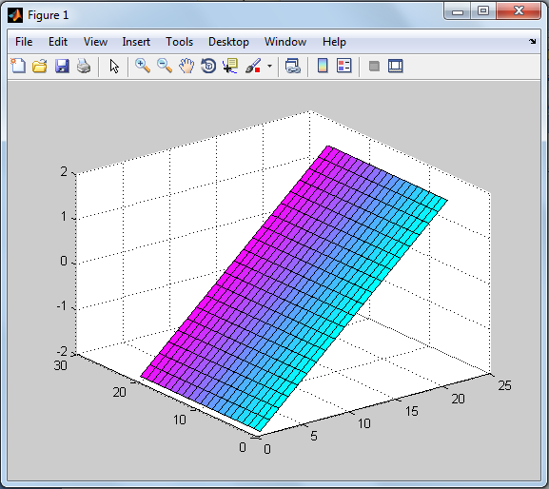
Example:4
[x,y]=meshgrid(-2:0.2:2,-2:0.2:2);
contour(x,y,x.^2-y.^2)
z=x*y;
surf(x,y)
%contourf(x,y,x.^2-y.^2)
%[x,y]=ginput(4)

Slide 23
The Process of Implementing a GUI Involves Two Basic Tasks:
Laying out the GUI components
  MATLAB implements GUIs as figure windows containing various styles of uicontrol (User Interface) objects.
Programming the GUI components
  Must program each object to perform the intended action when activated by the user of the GUI.

Slide 24
Example:1
%to display ‘HAI’
Steps:
Enter ‘guide’ on the command window.
A window created as:

Slide 25
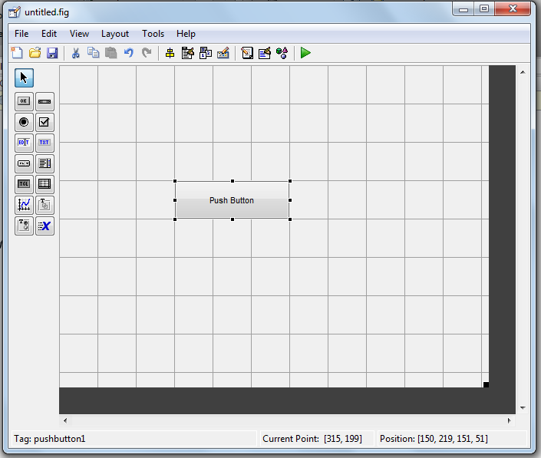
Click Blank GUI –> OK
Select which type of uicontrol component from the component palette needed and place it in the GUI window.
For this example we select the pushbutton

Slide 26
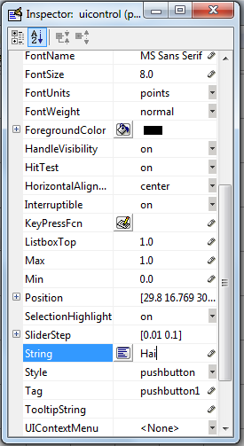
Change the name of the pushbutton by right clicking the pushbutton.
Save the GUI window.

Slide 27
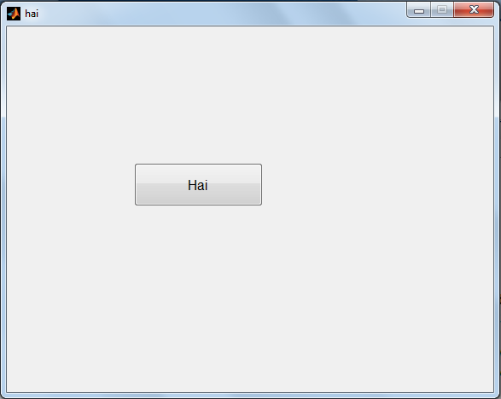
When a GUI is saved then it is saved in two forms:
1. in .fig
2. in .m

Slide 28
By pushing the button , the word HAI has to be displayed in command window. So we add ‘disp HAI’ in the callback of the pushbutton.
Click save and Run the Program.
when button pushed we get
>> hai
HAI
in the command window.

Slide 29
Callbacks
Routine that executes whenever you activate the uicontrol object.
Define this routine as a string that is a valid MATLAB expression or the name of an M-file.
The expression executes in the MATLAB workspace.

Slide 30
FIG-files
Binary files created as a result of saving a figure
Contains a serialized figure object
  A complete description of the figure object and all of its children
All of the objects property values are set to the values they were saved with when the figure is recreated

Slide 31
M-files
MATLAB generates the application M-file to provide a framework for the program that controls the GUI
All code, including the callbacks, is contained in the application M-file
  Each callback is implemented as a sub-function in the M-file

Slide 32
Example:2
% to create an adder
function input1_editText_Callback(hObject, eventdata, handles)
input = str2num(get(hObject,'String'));
if (isempty(input))
set(hObject,'String','0')
end
guidata(hObject, handles);

Slide 33
function input2_editText_Callback(hObject, eventdata, handles)
input = str2num(get(hObject,'String'));
if (isempty(input))
set(hObject,'String','0')
end
guidata(hObject, handles);

Slide 34
function add_pushbutton_Callback(hObject, eventdata, handles)
a = get(handles.input1_editText,'String');
b = get(handles.input2_editText,'String');
total = str2num(a) + str2num(b);
c = num2str(total);
set(handles.answer_staticText,'String',c);
guidata(hObject, handles);

Slide 35
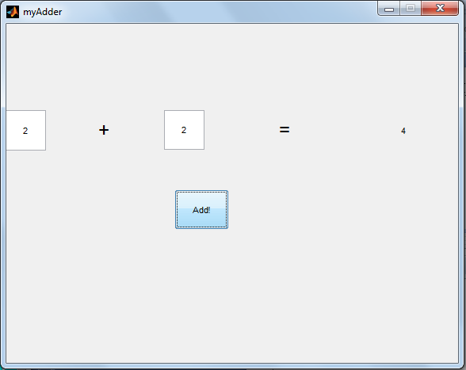
GUI window:Output

Slide 36
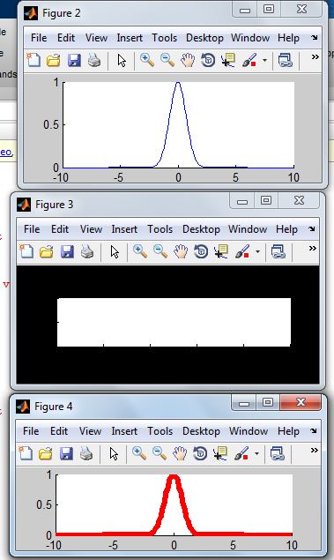
Matlab Graphics Objects
Output
Example:1
>> hf=figure;
ha=axes;
x=-10:0.1:10;
h=line(x,exp(-x.^2));
get(hf,'Type')
get(ha,'Parent')=hf;
P=get(ha,'Position');
set(ha,'Position',[P(1) P(2)+P(4)/4 P(3) P(4)/2]);
set(hf,'color',[0 0 0 ])
set(h,'color',[ 1 0 0],'Linewidth',5)
hf1=figure;
ha1=axes('Parent',hf1);
set(h,'Parent',ha1)

Slide 37
Example:2
hf=figure('MenuBar','none')
hTb=uitoolbar
hPT=uipushtool(hTb,'CData',zeros(8,8,3))
hTT=uitoggletool(hTb,'CData',zeros(8,8,3),'Separator','on')
hM=uimenu(hf,'Label','Test')
ha=axes('Position',[0.45 0.1 0.5 0.8])
hL(1)=plot([0:10],rand(11,1))
hL(2)=line([0:10],sin(pi*[0:10]/10),'Color',[1 0 0])
hL(3)=annotation('line',[0.75 0.75],[0 1],'Color',[1 0 0])
ha1=get(hL(3),'Parent')
hGo(1)=rectangle('Position',[4,1.5,1,0.2],'FaceColor',[0 0.5 0])
hGo(2)=line([4 5],[1.5 1.7],'Color',[1 0 0])
hG=hggroup
set(hGo,'HitTest','off','Parent',hG)

Slide 38
PanProp.Parent=hf
PanProp.Position=[0.05 0.1 0.3 0.8]
PanProp.Title='UI panel example'
PanProp.BackgroundColor=get(hf,'Color')
hPan=uipanel(PanProp)
UIPr.Units='normalized'
UIPr.Parent=hPan
UIPr.Position=[0.1 0.05 0.8 0.07]
UIPr.Style='pushbutton'
hUI(1)=uicontrol(UIPr,'String','Test Button')
UIPr.Style='listbox'
UIPr.Backgroundcolor=[1 1 1]
UIPr.Position=[0.1 0.17 0.8 0.75]
hUI(2)=uicontrol(UIPr,'String',fieldnames(get(hf)))

Slide 39
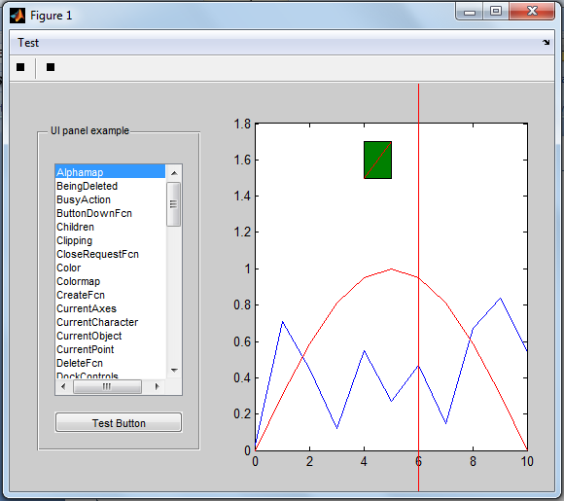
Output

Slide 40
Thank You

